Slide 1
Corporate Presentation
November 2020

Slide 2
Disclaimer
This document has been prepared by Epsilon Net S.A. (the “Company” or “Epsilon Net”) for use at presentations by Epsilon Net and/or the Advisors to Institutional Investors, held in connection with the proposed offering of shares of Epsilon Net (the “Offering”), and may not be used for any other purpose.
The information contained in this document has not been independently verified and no representation or warranty, express or implied, is made as to, and no reliance should be placed on, the fairness, accuracy, completeness or correctness of the information or opinions contained herein. None of Epsilon Net, Alpha Bank S.A. (the “Advisor”), or any of their respective affiliates, advisers or representatives shall have any liability whatsoever (in negligence or otherwise) for any loss howsoever arising from any use of this document or its contents or otherwise arising in connection with this document.
Neither the financial information nor any other information included herein have therefore been approved by the Athens Exchange (“ATHEX”) or the Hellenic Capital Markets Commission (“HCMC”).
This document does not constitute an offer or invitation to purchase or subscribe for any shares, and neither it nor any part of it shall form the basis of, or be relied upon in connection with, any contract or commitment whatsoever. Any decision to purchase shares in the Offering should be made solely on the basis of information to be contained in the prospectus, which is subject to approval by the HCMC and shall be published by the Company prior to the Offering.
This presentation is intended only for persons having professional experience in matters relating to investments and must not be acted or relied on by persons who are not Relevant Persons.
The information contained in the presentation is subject to amendment, revision and updating in any way without notice or liability to any party. The presentation contains forward looking statements which involve risk and uncertainties and actual results and developments may differ materially from those expressed or implied by the statements contained in the presentation depending on a variety of factors. No representation or warranty, either express or implied, is made as to the fairness, accuracy or completeness of the information or opinion contained herein, which has not been independently verified. Neither the delivery of this presentation at any time nor the offering, sale or delivery of any shares shall in any circumstance create any implication that there has been no adverse change, or any event reasonably likely to involve any adverse change, in the condition (financial or otherwise) of the Company since the date of the presentation.
None of the Company’s Advisors or connected persons are acting on behalf of any reader or recipient of the presentation and will not be responsible to any such person for providing the protections afforded to its customers or for advising any such person in connection with the company or the presentation. Nor do they accept any liability for any loss howsoever arising, directly or indirectly, from this presentation.
This presentation is not for distribution in, nor does it constitute an offer to sell or a solicitation of an offer to purchase securities. This presentation contains information that may or may not be included in the prospectus approved by the HCMC, whereas there might be information included in the prospectus and not contained here. Moreover, we have to underline that this presentation has not been filed with the ATHEX and/or the HCMC.
This presentation may be considered confidential and contains non-public information on Epsilon Net. As such information may be considered privileged information on the Company the recipients should abide to relevant legislation.
This presentation is made to and directed only at persons in the European Economic Area having professional experience in matters relating to investments who fall within the definition of “investment professionals” in Article 19(5) of the Financial Services and Markets Act 2000 (Financial Promotions) Order 2005 (the "Order") (such persons being referred to as "Relevant Persons").
This presentation and its contents are confidential and must not be distributed, published or reproduced (in whole or in part) or disclosed by recipients to any other person, whether or not they are a Relevant Person. The recipients of this presentation should not base any behaviour in relation to qualifying investments or relevant products (as defined in the Financial Services and Markets Act 2000 (FSMA) and the Code of Market Conduct made pursuant to FSMA) which would amount to market abuse for the purposes of FSMA on the information in this presentation until after the information has been made generally available. Nor should the recipient use the information in this presentation in any way which would constitute "market abuse". If you have received this presentation and you are not a Relevant Person you must return it immediately to the Company. This presentation does not constitute a recommendation regarding the securities of the Company.

Slide 3
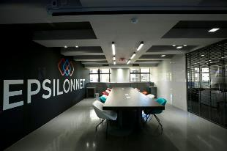
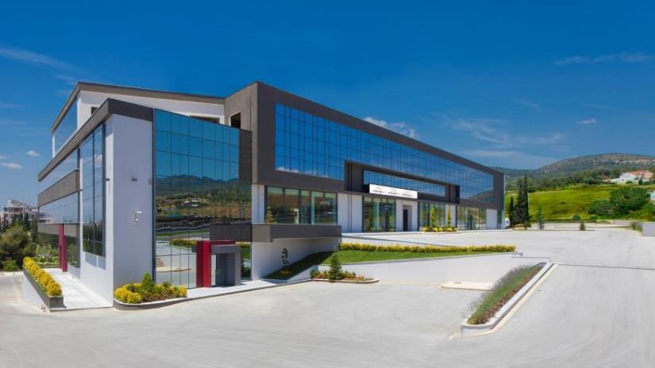
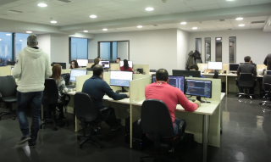
Our Facilities

Slide 4
Epsilon Net Group at a glance
7 Subsidiaries
1H 2020 Group Sales
€8.45 mn.
1H 2019: € 7.87 mn.
+370 Employees
+7,30 %
66% EBITDA Growth (2017-2019)
+35 Products
+300 Partners/Resellers
1H 2020 EBITDA
€1.83mn.
1H 2019 : €1.56 mn.
+17,07%
+30.000 Clients
12.000 Accountant offices
1H 2020 EBIT
€1.13 mn.
1H 2019 : €0.80 mn.
Sales breakdown
+39,97%
Best Workplaces
European Business Awards
1H 2020 Net Income
€1.00 mn.
1H 2019 : €0.65 mn.
No 1 “Client Support Services “
+54,03%
‘High Quality Support & Market Engagement’

Slide 5
Epsilon Net Timeline
Epsilon Net acquires 34% of HiT S.A.
€17.977.980
Development of PYLON, revolutionary technological platform
1st company to be listed in
the ATHEX Alternative Market
Dynamically entering in the software industry with «Extra Software»
1999
2005
2009
2016
2020
2008
2019
Listing in the Main Market of ATHEX
(15.07.2020)
2002
2013
Establishment of the company «Epsilon Net S.A.»
Epsilon Net acquires 51% of Ηoteliga International sp. Z o.o,
Development of Business HRM, for Payroll and Human Resources
Founding of «EPSILON HR S.A.»
Development of Business Software for SME’s
Epsilon Net acquires 80% of Data Communication S.A.
€1.359.000
Revenue Growth

Slide 6
Epsilon Net Flexible Business Model
Medium and Small enterprises are connected with accountant offices
Large Corporations & Conglomerates
ERP
CRM
Business
Intelligence
Epsilon Net penetrates in the market of Large and Medium enterprises through HRM & Payroll system
Medium Enterprises
ERP
CRM
Small Businesses
ERP
CRM
Software as a Service
100% mobile “Smart” Software
Traditional Software Business model
Epsilon Net Competitive Advantages
Unable to manage upgrade of enterprises
Customizable as the business grows
Difficult to readjust to new business size
Flexible Cost Policy / Pay-as-you-go model
Complex data migration process
Negligible migration costs
Limited interface according to user
Fully integrated online & cloud platforms

Slide 7
Epsilon Net Group Activity
Group activity is concentrated in IT& Innovation, with PYLON as the main platform for developing Business and IT solutions
Software & Innovation
PYLON Technology – Programming Software
PYLON Technology has been a milestone for Epsilon Net, paving the way for a multitude of IT solutions and expanding the company’s innovation potential
Accounting & Tax office Software
Payroll & HR Software
Business Software Solutions
Custom Software & Fintech Projects
Specialized information, 24/7 and advanced research tools for labor and tax issues
Educational Services
Sector trains
Sustainable ecosystem between new professionals and Epsilon Net software line
Information Database Systems
https://www.e-forologia.gr/
Leading online resource for accounting offices and accountants
96% of Revenues
4% of Revenues

Slide 8
Epsilon Net Product Portfolio & Customer Base (Dec.2019)
Accounting & Tax Office Software
8 Products
12.180 Clients
PYLON Software
12 Products
10.813 Clients
Payroll & HRM Software
7 Products
6.120 Clients
Vertical Markets
(Hotel – Restaurant – Auto – Gas Station)
9 Products
1.298 Clients

Slide 9
PYLON Development & Key Milestones
"Epsilon Smart", is a Web application for small and medium enterprises and freelancers, that issues all the tax documents needed by computer - tablet - mobile.
Epsilon smart is a complete commercial application (purchases, sales, warehouse, receipts, payments, crm, calendar) and online issuance of tax documents.
2020
Introduction of PYLON Production (Production Management Software)
2017
2018
Introduction of PYLON ERP & PYLON WEB ENTRY
Introduction of PYLON Commercial / CRM
2016
2015
Introduction of PYLON HO.RE.CA (Hotel, Restaurant, & Catering Management)
2013
Inauguration of PYLON platform for software programmers

Slide 10
PYLON at a glance
What is it?
PYLON is a uniquely integrated, unified, pioneering software development platform developed by Epsilon Net. The PYLON system offers a series of unique advantages to all applications developed on it, extremely important and essential for the success of a business
How does it work?
Pylon Development Framework provides a foundation on which developers can rapidly build standalone, individual applications as well as fully integrated solutions adjustable to any future technology changes.
What can it be used for?
Pylon Hybrid Technology provides the ability to build cross-environment, low-cost and sophisticated solutions which meet modern business requirements and needs.
PYLON Main Product Portfolio
PYLON Commercial
Commercial Store Management
PYLON ERP
Business Management
PYLON CRM
Customer Relationship Management
Full Web Application for small and medium enterprises
PYLON Business Accounting
Accounting Office Audit Functions
PYLON Shop
SOHO Retail Management
PYLON Hotel
Hotel Management
PYLON Restaurant
Restaurant Management
PYLON Auto
Auto Service & Spare Parts Management
PYLON Entry
Simplified Small Business Management
PYLON Web Entry
Online Simplified Business Management
PYLON Retail Retail Store Management

Slide 11
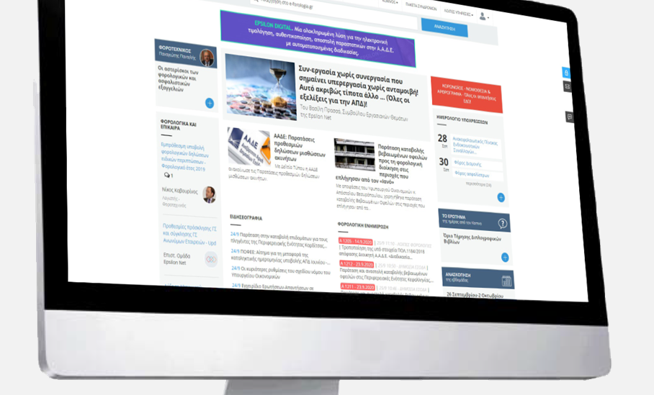
e-Forologia.gr
Leading Financial, Tax & Labor Legislation Portal with +65k monthly visits & +15k scientific Q&A’s
Strong and trusted brand in the Greek accounting industry serving as a strong lead generation for the core accounting software.
Reliable information
Daily Articles
Calendar
Online e-Bookstore
Tax information
Interviews
Weekly review
Scientific team
New users per annum
1,593,047
Pageviews per annum
11,544,340
Sessions per annum
7,693,946

Slide 12
Increasing Profitability Trends
Increasing profitability trends showcased by a steady increase in Gross and pre-tax profit, sales and EBITDA.
Steady increase of ROE exemplifies efficient capital employment & profit generation.
+10,8%
+37,0%
+15,2%
+21,1%
+7,3%
+17,1%

Slide 13
Robust base of recurring revenue
Strong customer retention builds resilient base of recurring revenue
Recurring Revenue
Customer retention | 97,5% | 97,8% | 98,2% | 98,5%
Customer
Retention

Slide 14
Efficient cash conversion
Positive cash flows throughout the period 2017 – June 2020 despite large investing cash flows.
Increasing trend in operating cash flows.
30.06.2020 | € |  | FY 2019 | €
Total Intangible Assets | 4.633 |  | Total Intangible Assets | 4.837
01.01.2020-30.06.2020 | € |  | 01.01.2019-30.06.2019 | €
Period Intangible Assets | 188,4 |  | Period Intangible Assets | 938,8
30.06.2020 | € |  | FY 2019 | €
Depreciation | 703,8 |  | Depreciation | 1.511
Epsilon Net has steadily been investing significant amounts in R&D over the years, to optimize product growth and amplify innovation.
Company's strategy focuses that the biggest part of R&D costs finally are driven to Expenses account

Slide 15
Corporate Strategy

Slide 16
Corporate Strategy – ACCOUNTING OFFICES
Positioning
Competitors
Market share
Total Market Share
Penetrating potential clients via Accounting Offices
Small & Medium Enterprises (+800k)
* All figures are based on our estimations

Slide 17
Corporate Strategy - HR
Positioning
Competitors
Market share
Market Share
Epsilon Net Market Share breakdown
* Number of Employees
* All figures are based on our estimations

Slide 18
Corporate Strategy – Commercial Software – ERP
Competitors
Positioning
Market share
Total Market Share
(Small, Medium & Large Enterprises)
Epsilon Net Market Share breakdown
Other Competitors in Vertical Markets
* Number of Employees
* All figures are based on our estimations

Slide 19
Epsilon Net Acquires 80% of Data Communication (Oct. 2020)
TOTAL INVESTMENT €6,3m
Accounting & Tax Office Software
Large & Medium-sized businesses
SOLID CLIENT BASE
3,500 Clients
EXCELLENT BRANDNAME
Payroll & HRM Software
EFFICIENT MANAGEMENT & WORKING FORCE
800 Clients
Commercial Software for SME
2,000 Clients

Slide 20
Business Opportunity

Slide 21
Strategy of increasing Market Share in Greece
Significant increase of Pylon ERP products through the penetration of existing clientele.
Enlargement of market share in HRMS products and Accounting Offices. Non-stop investments for new PYLON sub products.
Transfer of all existing clientele into new PYLON Cloud & Web technology .
Strengthening vertical markets

Slide 22
Digital Transformation
Utilizing the broadening of the market due to digital transformation of SME’s and new legislation of e- invoicing (official start Jan.2021)

Slide 23
e- invoice
On line data sending to
Major Business Opportunity!
Official Launch Jan.2021

Slide 24
Leveraging superior route to market
PYLON ERP & HRM
Existing clients
Large & Medium-sized businesses
Tax accounting office
+18.000 Clients
+12.000 Clients
Penetration in large & medium-sized businesses through digitization, vertical offerings and adjacent product offerings
PYLON Commercial
On average, there are 40 customers per tax accounting office
New clients
Medium & Small sized businesses
Potential +450.000 Clients

Slide 25
Uniquely positioned to navigate complicated regulatory environment
Constantly changing tax framework for businesses
450 new directives that change the tax obligations of companies in 2020
Live Phone Support Daily from 09:00-21:00
}
55% market share in Accounting offices
Constantly changing framework of labor and insurance legislation
+
280 new directives on labor and insurance regulations in 2020
41 new versions of software applications for accounting offices

Slide 26
Evolution of customer growth
# Customers
1. The production of Pylon Platform began 2013 and the first products were launched 2015.
2. Consolidation of Scan HRMS - 2016
3. Launch of Smart web platform for Small Businesses – Mar. 2020
4. Smart Clients Oct. 2020 – 1.819.
+2.041
ERP + Vertical Markets
+4.069
+2.030
+3.465
+1.025
(1)
+477
+200
+407
HR/Payroll
+319
+920
(2)
+1600
+500
Accounting software
+1380
+1500
+1300
Medium & Small sized businesses
Cloud
+615
+438
+115
+284
+33
(3,4)

Slide 27
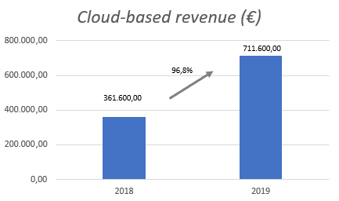
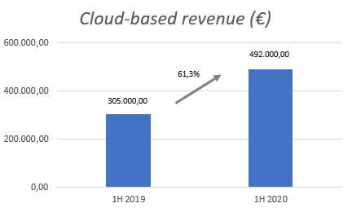
Offering leading cloud-based software solutions
cloud-based software products and platform simplifies the business and modernizes the control of a company. Revolutionary online services for accountants and accounting firms that combines information, and expense savings.
cloud-based software solutions offers:
24/7 ACCESS
REGISTRATION OF EXPENDITURES
OMNI-CHANNEL SUPPORT
CUSTOMER / SUPPLIER LEDGERS
E-DATABASE OF TAX RETURNS ETC.
TRANCACTION DATA
PAYROLL DATA
FINANCIAL DATA OF THE COMPANY
HR PAYROLL

Slide 28
Leading provider of e-invoice solutions
Epsilon Smart is a web application that has been developed with the most modern development tools to make the most of the latest technologies.
The result of these technologies is the unique user experience and the necessary functionality for professionals, in a web environment guaranteed by Microsoft Azure.
Through flexible subscription models for both self-employed and small and medium-sized enterprises:
Communicate with the my DATA platform of Independent Authority for Public Revenue
Issue the all required tax documents
They issue retail receipts even without the use of a tax mechanism
They operate with an integrated circuit of documents and warehouse monitoring
They have an immediate view of their financial situation at a glance (cashier, receipts, payments)
Organize their All the above are functioned via pc, tablet, smartphone, from any web browser and with Android & i / OS native applications through a flexible CRM
Epsilon Smart offers:
Complete control of the company with Commercial & Financial Management
Organization and security of the Company’s data, offered by the Microsoft Azure cloud platform
4 flexible types of subscriptions to choose the one that meets your needs

Slide 29
6. Financial Overview

Slide 30
P&L Statement 2019- June 2020
in thousands of € | 1.1-30.06.2019 | 1.1-30.06.2020 | 1.1-31.12.2018 | 1.1-31.12.2019
Sales | 7.870,96 | 8.445,36 | 16.227,74 | 17.977,98
Cost of sales | -3.642,10 | -3.649,25 | -7.676,29 | -7.773,93
Operating income | 4.228,86 | 4.796,11 | 8.551,45 | 10.204,05
Other operating income | 29,79 | 29,30 | 143,37 | 55,14
Administrative expenses | -139,11 | -134,71 | -300,21 | -301,68
R&D expenses | -1.750,27 | -2.322,98 | -3.894,87 | -5.567,95
Distribution expenses | -1.482,27 | -1.170,02 | -3.174,67 | -2.343,65
Other operating expenses | -82,78 | -71,99 | -56,83 | -291,59
EBIT | 804,22 | 1.125,70 | 1.268,24 | 1.754,32
Financial income | 20,62 | 16,09 | 19,55 | 39,00
Financial expenses | -176,87 | -214,05 | -245,98 | -391,18
Associates | -13,48 | 54,95 | 6,77 | -34,08
Net income before tax | 634,49 | 982,69 | 1.048,59 | 1.368,06
Tax | 14,82 | 17,41 | -9,65 | 40,22
Net income after tax (A) | 649,30 | 1.000,10 | 1.038,94 | 1.408,28
Divided into:
Shareholders | 508,80 | 932,07 | 824,72 | 1.161,89
Non-controlling interests | 140,51 | 68,02 | 214,22 | 246,39
Total | 649,30 | 1.000,10 | 1.038,94 | 1.408,28
Other Comprehensive Income after tax
Actuarial gains and losses from Personnel Benefit Programs |  |  | - | -71,80
Tax |  |  | - | 17,23
Other Comprehensive Income after tax (B) |  |  | - | -54,57
Total Comprehensive Income after tax (A)+(B) | 649,30 | 1.000,10 | 1.038,94 | 1.353,71
Divided into:
Shareholders | 508,80 | 932,07 | 824,72 | 1.108,81
Non-controlling interests | 140,51 | 68,02 | 214,22 | 244,90
Total | 649,30 | 1.000,10 | 1.038,94 | 1.353,71

Slide 31
Balance Sheet 2019- June2020
in thousands of € | 30.06.2020 | 31.12.2018 | 31.12.2019
Assets
Non-current assets
Tangible fixed assets | 2.723,87 | 1.095,07 | 2.881,60
Intangible Asets | 4.633,32 | 5.542,69 | 4.837,22
Investments in Subsidiaries | - | - | -
Investments in Associates | 1.200,84 | 179,97 | 1.145,89
Other equity instruments | 3,52 | 3,52 | 3,52
Deferred Tax Assets | 132,86 | - | 79,21
Investment Instruments | - |  | -
Other long term receivables | 78,36 | 68,61 | 73,17
Total | 8.772,75 | 6.889,86 | 9.020,61
Current Assets
Inventory | 35,31 | 33,96 | 20,14
Accounts receivable | 8.014,75 | 7.567,25 | 8.668,13
Financial Assets at fair value through Profit and Loss Statement | 259,49 | 265,51 | 268,92
Other current assets | 1.328,68 | 336,9 | 535,03
Cash and cash equivalents | 11.127,54 | 7.708,63 | 8.593,95
Total | 20.765,76 | 15.912,26 | 18.086,17
Assets total | 29.538,52 | 22.802,12 | 27.106,78
Equity and Liabilities
Equity
Equity Capital | 4.020,00 | 3.352,63 | 3.352,63
Treasury Shares | -35,86 | - | -35,86
Share Capital Premium | 0,01 | 0,01 | 0,01
Revaluation difference - investment grant | - | - | -
Other Reserves | 1.415,49 | 1.327,91 | 1.415,49
Retained Earnings | 9.382,07 | 7.168,15 | 8.204,74
Total Equity attributed to shareholders | 14.781,70 | 11.848,70 | 12.937,00
Non-controlling interests | 404,26 | 226 | 569,55
Total Equity | 15.185,96 | 12.074,70 | 13.506,55
Long-term liabilities
Borrowings | 5.140,43 | 4.961,96 | 4.252,79
Leasing liabilities | 1.338,16 | - | 1.439,56
Deferred tax liabilities | - | 36,3 | -
Pension provisions | 1.218,40 | 938,47 | 1.107,87
Other long-term liabilities | 132,90 | 134,54 | 133,27
Total Long-Term Liabilities | 7.829,89 | 6.071,28 | 6.933,49
Short-term liabilities
Accounts payable | 1.581,48 | 1.236,26 | 1.439,56
Short-term loans | - | - | -
Short-term part of long-term loans | 1.494,43 | 900,84 | 2.552,05
Short-term part of long-term leasing liabilities | 365,25 | - | 348,42
Taxes payable | 1.602,61 | 1.176,91 | 1.415,20
Other short-term liabilities | 1.478,91 | 1.342,13 | 911,51
Total Short-Term Liabilities | 6.522,67 | 4.656,15 | 6.666,74
Total Liabilities | 14.352,56 | 10.727,42 | 13.600,23
Total Equity and Liabilities | 29.538,52 | 22.802,12 | 27.106,78

Slide 32
Cash Flow Statement 2019- June 2020
 | 1.1-30.06.2019 | 1.1-30.06.2020 | 01.01 - 31.12.2018 | 01.01 - 31.12.2019
in thousands of €
Operating activities
Profit before tax | 634,49 | 982,69 | 1.048,59 | 1.368,06
Reconciliation adjustments:
Depreciation | 758,50 | 703,84 | 1.114,43 | 1.510,55
Provisions | 67,89 | 180,66 | 62,11 | 372,89
Currency effect on operating activities | 0,04 | (9,43) | 0,09 | 3,42
Results of investment activities | (16,02) | (28,55) | 5,88 | -28,49
Interest and other expenses | 175,03 | 227,91 | 245,98 | 397,15
Plus/minus changes in working capital
Change in invetory | 10,34 | (15,17) | 7,17 | 13,82
Change in assets | 1.609,00 | (324,32) | 34,26 | -994
Change in liabilities-excluding loans | (1.429,81) | 1.722,30 | -1.102,57 | -68
(Minus):
Interest and other expenses | (121,21) | (203,95) | -283,69 | -344,05
Taxes paid | (5,21) | (47,20) | -52,64 | -58,06
Cash flows from operating activities | 1.683,04 | 3.188,78 | 1.079,60 | 2.173,29
Investing activities
Acquisitions of subsidiaries, associates, joint ventures and other investments | - | (64,38) | -6,77 | -1.000,00
Purchase of fixed and intangible assets | (1.007,80) | (251,33) | -587,55 | -493,89
Proceeds from sale of fixed and intangible assets | - | 2,00 | 18,26 | 8
Interest payments received | 14,32 | 25,97 | 19,01 | 54,62
Proceeds from Grants | - | 1,88
Other | 15,22 | 9,43 | 60,65 | -1,63
Cash flows from investing activities | (978,26) | (276,43) | -496,4 | -1.432,90
Financing activities
Proceeds from share capital increase |  |  | - | 98,65
Share capital decrease payments | (446,20) | - | - | -446,2
Treasury Shares | (35,86) | - | - | -35,86
Debt issuances | 95,41 | - | 3.803,29 | 2.195,52
Loan repayments | (480,38) | (172,65) | -802,41 | -1.294,72
Amortization | (185,32) | (206,11) | - | -372,45
Cash flows from financing activities | (1.052,36) | (378,76) | 3.000,88 | 144,93
Change in cash and cash equivalents | (347,58) | 2.533,59 | 3.584,09 | 885,31
Cash and cash equivalents beginning of period | 7.708,63 | 8.593,95 | 4.124,55 | 7.708,63
Cash and cash equivalents end of period | 7.361,06 | 11.127,54 | 7.708,63 | 8.593,95

Slide 33
Data Communication Financial Overview
 |  | 30.06.2017 |  | 30.06.2018 |  | 30.06.2019
Turnover (Sales) |  | 5.933.653,52 |  | 6.285.874,51 |  | 6.153.820,22
Gross Operating Results Profit / - Loss |  | 2.071.330,41 |  | 2.281.212,43 |  | 2.267.922,48
Operating Results Profit / - Loss |  | 117.376,29 |  | 106.945,64 |  | 94.219,81
Net Income Before Taxes |  | 56.253,21 |  | 68.235,74 |  | 51.937,52
Net Income After Tax |  | 16.432,44 |  | 11.265,12 |  | 8.887,51
Large & Medium-sized businesses

Slide 34
Appendix

Slide 35
Epsilon Net Management & HR Overview
Administrative
Technical & Financial / Labor Science Support
Women
Sales & Marketing
Total
374
Men
R&D
49%
87%
61%
Of employees have higher education degrees
Of employees under 38
Of employees under 50
more than 20 Years Experience
in Information Systems Technology

Slide 36
Stock Statistics
3€
2€
1€
Epsilon Net Chart
June ‘20 July ‘20 August ‘20 September ’20 October ‘20 November ‘20
Source: Inforex
General Information
Shareholders Structure - 31.10.2020
Capitalization (31.10.2020 €2,94) | € 39,396,000
Shares Outstanding | 13.400.000
ISIN | GRS498003003
Bloomberg | EPSIL:GA
Listing Day Main Market ATHEX | 15.07.2020

Slide 37
Thank you
Epsilon Net Α.Ε.
https://www.epsilonnet.gr/
Contact Person: John Koutkoudakis – 0030 211 5007000
gk@epsilonnet.gr

